Slide 1

Check-in

Slide 2

iClicker Question
Constructs exist in the real world, and you can measure and quantify them. While variables exist in the conceptual/theoretical domain, and you can't measure them.
TRUE
FALSE

Slide 3
Construct and Variables
Construct is “an abstract idea or concept composed of a set of attitudes or behaviors that are thought be related.”
Conceptual/Theoretical Domain
Construct A
Construct B
Variables are ”elements of a construct that can be measured or quantified”
Variable X
Variable Y
Real world
Notes:
Just a reminder that constructs exist only in the conceptual world.
What we see in the real world are only manifestations of constructs which are called variables.

Slide 4

iClicker Question
Difference analysis requires your grouping variable to be continuous.
TRUE
FALSE

Slide 5
Another representation
Categorical/
Discrete
Difference
Analysis
X
Y
Continuous
X
Y
Association
Analysis

Slide 6
Recap Last Class
Reminder: Evidence of Causality
Constructs vs. Variables
Analyses:
Descriptive
Difference
Association

Slide 7




Collecting Descriptive Primary Data
Notes:
Chapter 9

Slide 8

Chapter 9: Collecting Descriptive Primary Data – Learning Objectives
Cite three major purposes of descriptive research
List the six specifications of a descriptive study
Discuss the difference between cross-sectional and longitudinal designs
Explain what is meant by a panel in marketing research, and explain the difference between a continuous
List the kinds of demographic and socioeconomic characteristics that interest marketers

Slide 9
Three Purposes of Descriptive Research
Describe the characteristics of certain groups
Estimate the proportion of people who behave in a certain way
Make specific predictions
Exploratory research is very flexible; descriptive research is MUCH more rigid
Descriptive research requires the clear specification of WHO, WHAT, WHEN, WHERE, WHY, HOW before data collection can begin
Notes:
A research group gathered info from individuals who had eaten at a particular barbecue restaurant chain in a Midwestern US city to help managers develop a profile of the “average user” (e.g., income, sex, age, …)
Estimate the proportion of people within a specified radius of a proposed shopping complex who currently shop or intend to shop at the center
Might want to predict the level of sales for a certain brand for each of the next five years so that we could plan for the hiring and training of new sales rep
Even though we list prediction as one the three purposes here. I can tell you that we rarely use it under descriptive research. We usually still use causal research to answer this question.

Slide 10
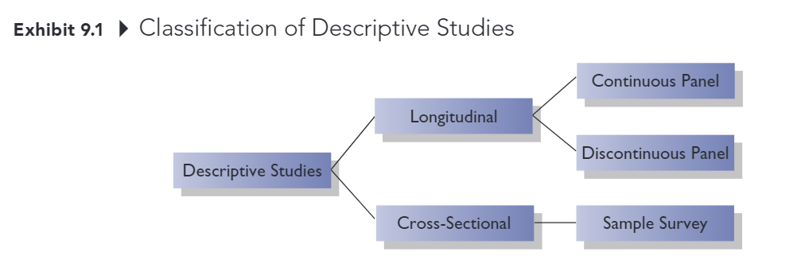
Classification of Descriptive Studies
Notes:
Under descriptive research, you have longitudinal and cross-sectional data

Slide 11

Classification of Descriptive Studies
Longitudinal study: Investigation involving a fixed sample of elements that is measured repeatedly through time
Continuous panel: A fixed sample of respondents who are measured repeatedly over time with respect to the same variables
Discontinuous panel: A fixed sample of respondents who are measured repeatedly over time but on variables that change from measurement to measurement
Cross-sectional study: Investigation involving a sample of elements selected from the population of interest that are measured at a single point in time
Sample Survey: Cross-sectional study in which the sample is selected to be representative of the target population and in which the emphasis is on the generation of summary statistics such as averages and percentages

Slide 12
Types of Primary Data
Demographic/socioeconomic characteristics
Personality/lifestyle characteristics
Attitudes
Awareness/knowledge
Intentions
Motivation
Behavior
Notes:
These are the 7 types of primary data that you usually encounter in marketing
We will go over each type

Slide 13
Demographic Socioeconomic Characteristics
Often used to divide a population into groups (e.g., for market segmentation purposes)
Some commonly measured variables:
Age
Income
Occupation
Education
Gender
Ethnicity
Notes:
Data from demographic or socioeconomic characteristics are usually taken as grouping variables, as some of you choose to differentiate between athlete and non-athlete students, or between Greek students and non-Greek students.

Slide 14
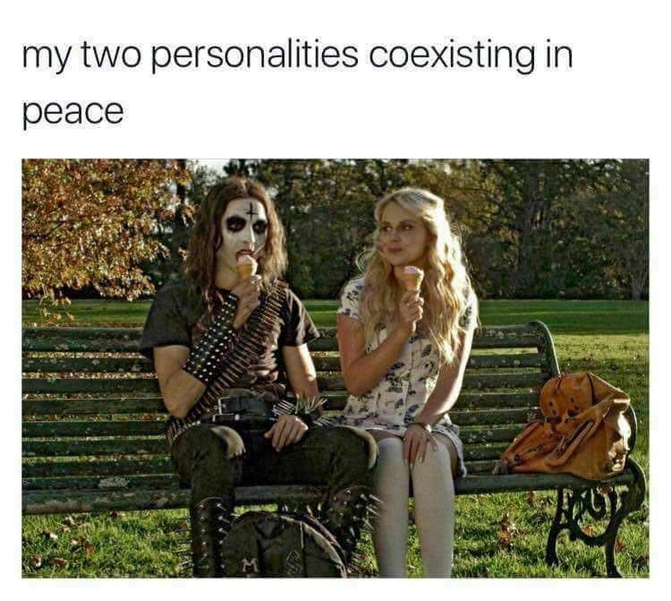
Personality/Lifestyle Characteristics
Personality: normal patterns of behavior exhibited by an individual; the attributes, traits, and mannerisms that distinguish one individual from another
Lifestyle: How individuals live, what interests them, their values, and what they like
Notes:
The second type of primary data is personality or lifestyle characteristics
Personality is …
Lifestyle is …
I think you can differentiate and understand these terms pretty well
Is there any questions?

Slide 15

iClicker Polls
Can you trust data from third-party companies (e.g., Google or Facebook) that have already developed consumer profiles with sophisticated tools (e.g., machine learning or AI)?
Yes
No

Slide 16
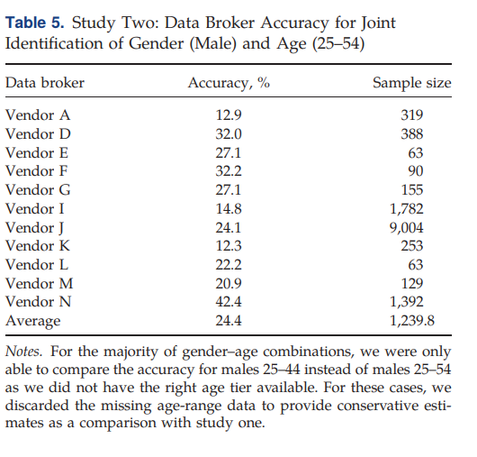
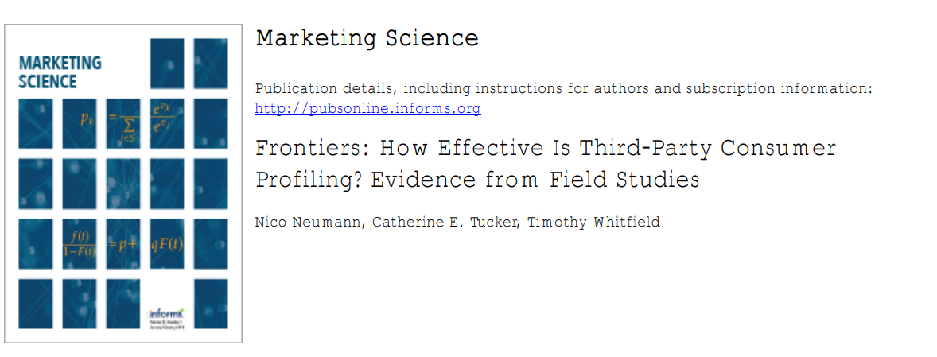
Caveat – Careful with black box methods
Notes:
Neumann et al. (2019)
Across several vendors, the authors found that the true accuracy of targeting for these Demand-side platforms (DSPs) is extremely low. It could even be better not to use target ads.

Slide 17
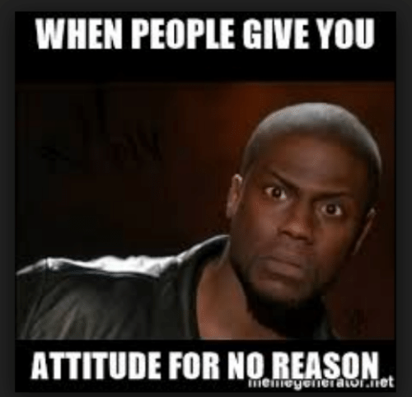
Attitudes
An attitude is an individual's overall evaluation of something
Marketers often measure people’s attitudes toward companies, products, and services. They also measure may “attitude-like” variables including value, quality, and satisfaction.
Notes:
Satisfaction towards machine and equipment is different from satisfaction towards the basketball court.
Hence you have to keep it in mind when creating your survey. You have to be very specific when asking your respondents.
A question asking about attitude towards the gym as a whole is different from attitude towards the staff

Slide 18
Awareness/ Knowledge
Insight into, or understanding of facts about, some object or phenomenon.
Marketers often want to know what individuals know or believe about products, brands, companies, advertisements, and so on.

Slide 19
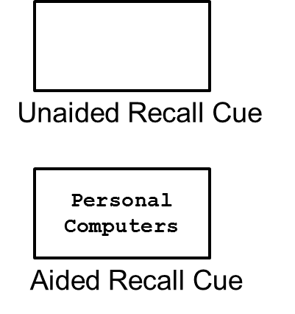
Measuring Awareness
Unaided Recall: For what products and brands do you remember seeing ads?
Aided Recall: Do you remember seeing ads for personal computers?
Notes:
Unaided recall is how well a consumer remembers an advertisement without any external help such as clues, or visuals.
Unaided
What bottled water brands are you familiar with? (Please write your answers in the box below)
Aided
Which of the following bottled water brands have you heard of? (Select all that apply)
Aquafina
Dasani
SmartWater
(Insert your brand name)
Fiji

Slide 20

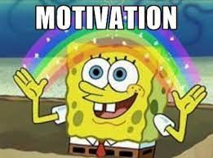
Motivation
A need, a want, a drive, a wish, a desire, an impulse, or any inner state that energizes, activates, moves, directs, or channels behavior toward goals
If we understand what drives consumer behavior, we are in better position to anticipate consumer needs and offer products and services that satisfy those needs.

Slide 21

Intentions
Anticipated or planned future behavior
Marketers often need this type of information to assess demand for a product or service
Estimating demand for products and services accurately is one of the most difficult tasks a marketing researcher faces:
Theory of Reasoned Action: Fishbein & Ajzen (1975)
Notes:
Definitely would buy
Probably would buy
Undecided
Probably would not buy
Definitely would not buy

Slide 22
Behavior
What subjects have done or are doing
Behavioral data might be obtained by observing behaviors or by asking consumers to remember and report their past behaviors.

Slide 23
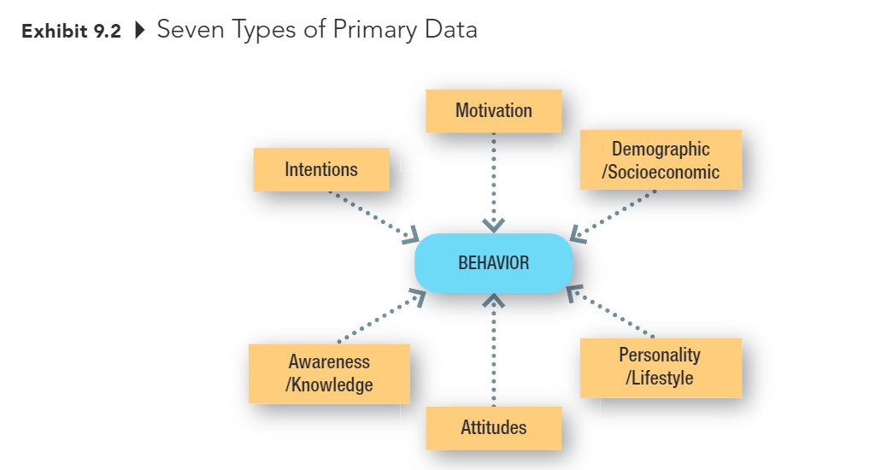
Types of Primary Data
Notes:
There is another representation of the seven types of primary data
What does this representation remind you of?
This looks like a causal model or framework right?
There is an implicit assumption that the first six constructs will affect behavior.
Since in marketing, we want to affect the purchase behaviors of consumers, we want to leverage as much information about the other constructs as possible you make informed decisions on allocating resources.
Moreover, you can see we assume intention leads to behaviors. But that is not always the case, people can say that will likely to buy, but it does not mean they will.
In my research, I also study this aspect of data collection.

Slide 24
Brand Equity Research
Brand Equity
0.5
Brand Performance
0.25
Brand Loyalty
Brand Awareness
Brand Association
Perceived Quality
Notes:
A little bit about my research
If brand performance is measured by survey data which typically measured by survey, the correlation between brand equity and performance is 0.5
If brand performance is measured by actual sales, which is observed behaviors, the correlation between brand equity and performance is 0.25

Slide 25

Chapter 10: Collecting Data by Observation – Learning Objectives
Describe the two basic means of obtaining primary data
State the specific advantages of each method of data collection
List the important considerations in the use of observational methods of data collection
Explain the difference between structured and unstructured observation.
Cite the main reason researchers may choose to disguise the presence of an observer in a study
Explain the advantages and disadvantages of conducting an observational experiment in a laboratory.
List several approaches to mechanical observation
Notes:
These are the learning objectives in chapter.
You can recall it afterward

Slide 26
Two Methods of Data Collection
Communication
A method of data collection involving questioning respondents to secure the desired information using a data collection instrument called a questionnaire.
Observation
A method of data collection in which the situation of interest is watched, and the relevant facts, actions, or behaviors are recorded
Notes:
One is interrupted interview
The other is uninterrupted observation
In chapter 10 we will go into detail of collecting data by observation.

Slide 27
Communication vs. Observation
Attribute | Communication | Observation
Versatility | 4
Speed | 4
Cost | 4
Objectivity |  | 4
Accuracy |  | 4
Notes:
You have to make trade-off between the two types of data collection

Slide 28
Why use observation research?
Observation is often the best method for generating valid data about an individual’s behavior.
Using communication methods, we can ask a consumer to estimate how many jars of peanut butter he purchased at a particular store in the past year.
With observation method, we can KNOW how many jars he purchased at that store in the past year.
Notes:
If you think again about the intention and behavior, they are also related to observation and communication methods.
SO how would you pair them together?

Slide 29
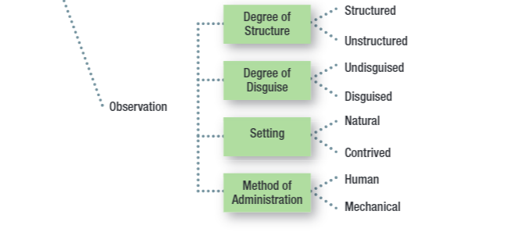
Key Issues for Collecting Information by Observation
Notes:
When collecting information by observation, or when firms create a database to collect observation data, one needs to consider
Degree of structure
Degree of disguise
Setting
Method of Administration

Slide 30
Structured Observation
Structure: The degree of standardization used with the data collection instrument.
Method of observation in which the phenomena to be observed (typically behaviors) can be defined precisely along with the categories used to record the phenomena.
Notes:
I think you all should be very familiar with data structure by now.
So structured observation can be in data table, and methods of observation is clearly laid out.
For example if this person purchase an apple, record it in the database.

Slide 31
Unstructured Observation
Method of observation in which the researcher has a great deal of flexibility in terms of what to note and record.
Notes:
On the other hand, …
For example, you try to record everything that is being said on social media into text format with any structure of recording.

Slide 32
Disguise
The amount of knowledge people have about a study in which they are participating

Slide 33
Disguised vs Undisguised Observation
With disguised observation, subjects are not aware that they are being observed
Ethical considerations -> Debriefing
With undisguised observation, subjects are aware that they are being observed
Notes:
Why would you think that undisguised observation might affect the result of our study?
Desirability bias.

Slide 34
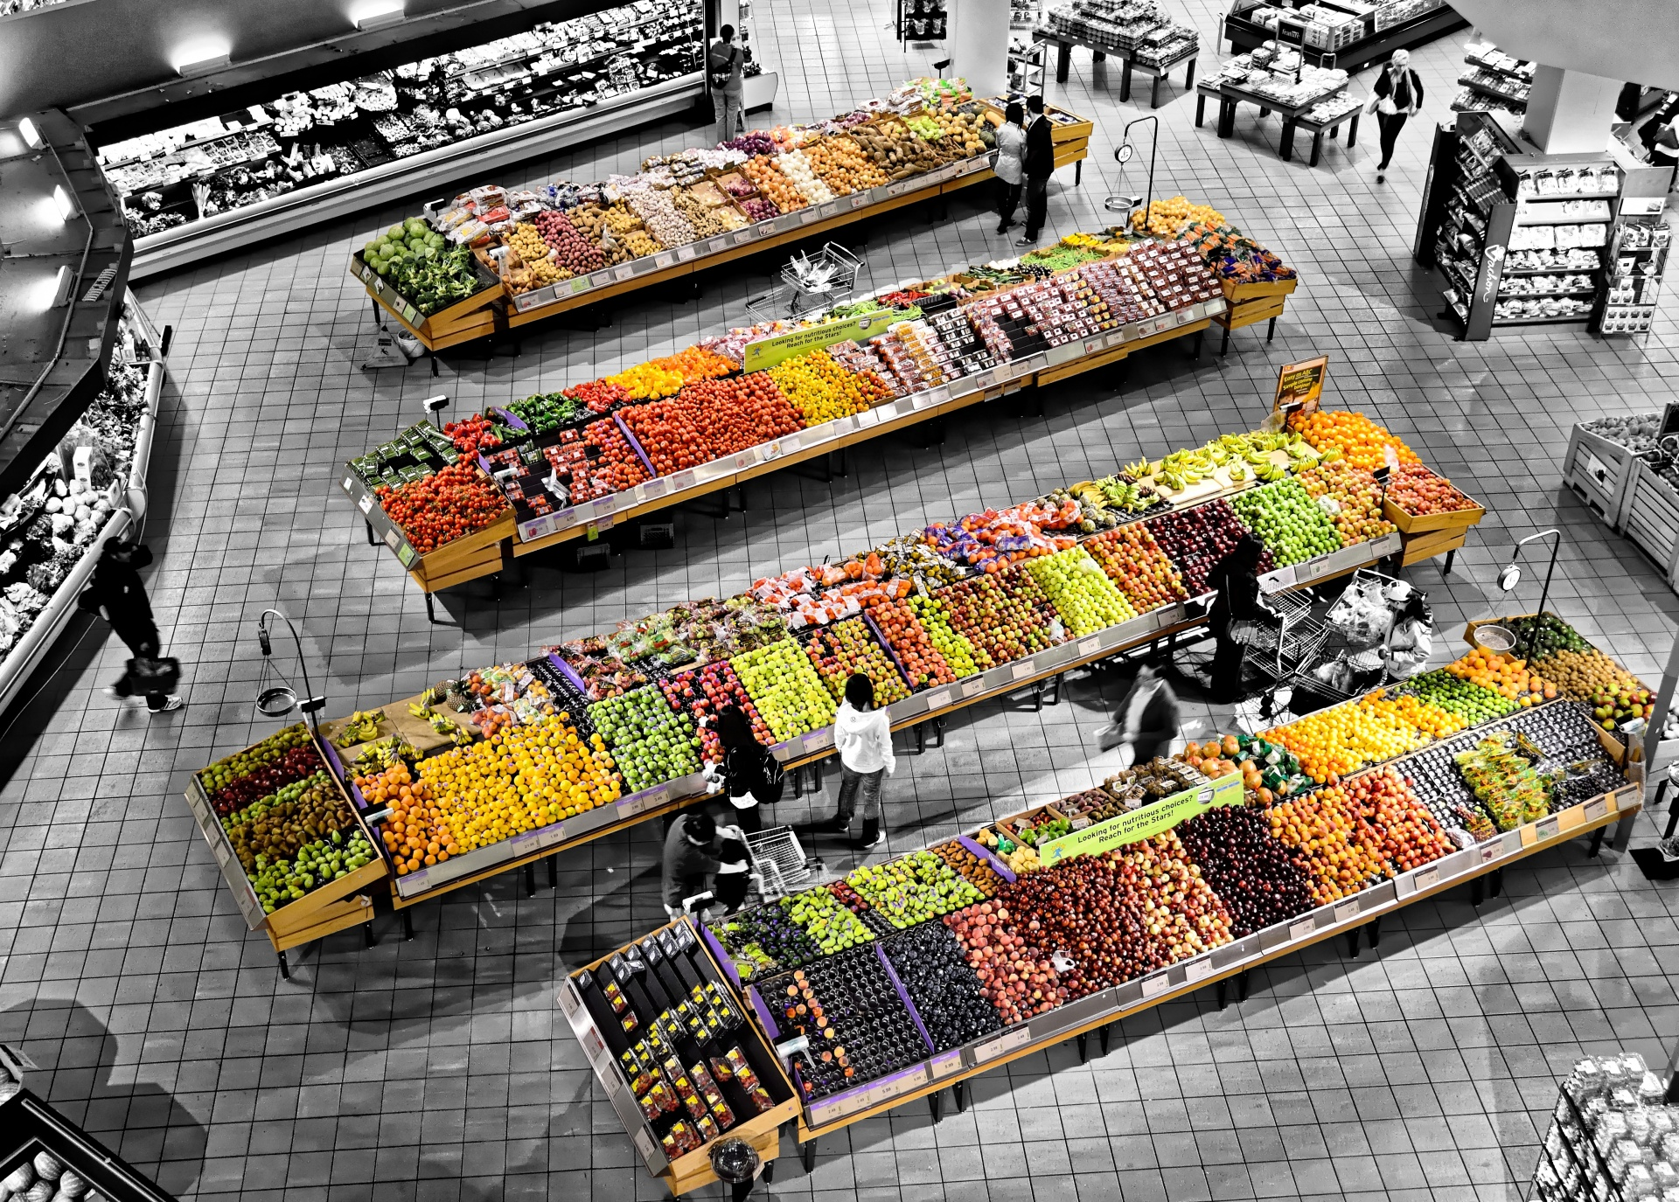
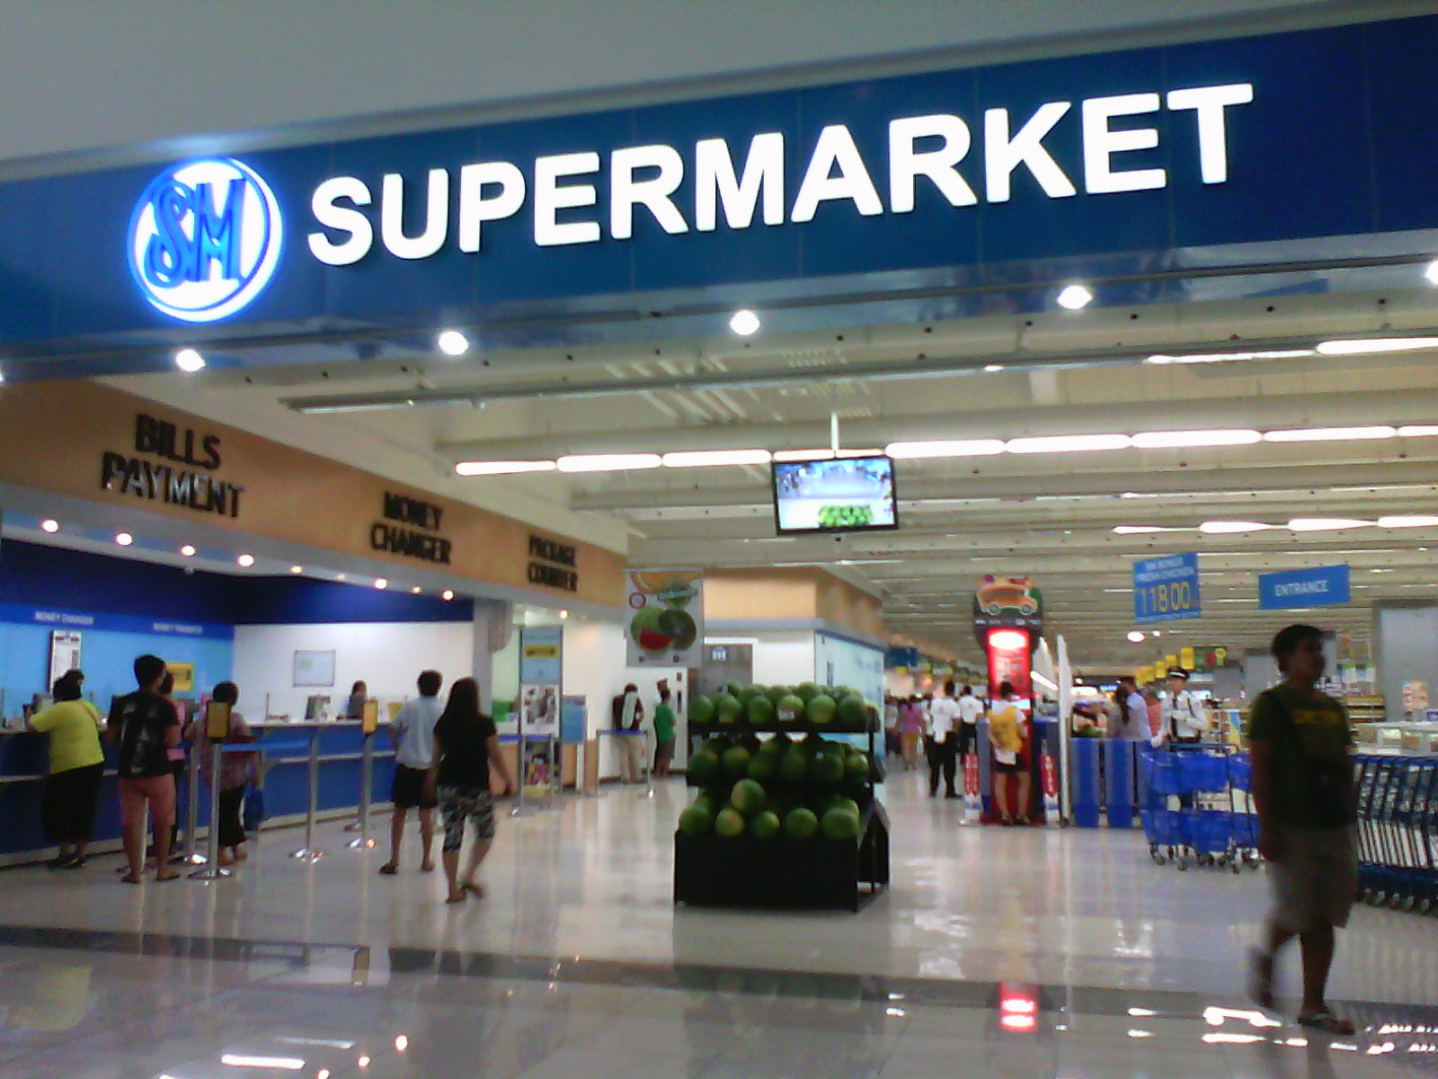
Natural Setting
Subjects are observed in the environment where the behavior normally takes place
Shopping in a store
Using or consuming a product at home
This Photo by Unknown Author is licensed under CC BY-SA
Notes:
The third consideration is setting: natural versus contrived.

Slide 35
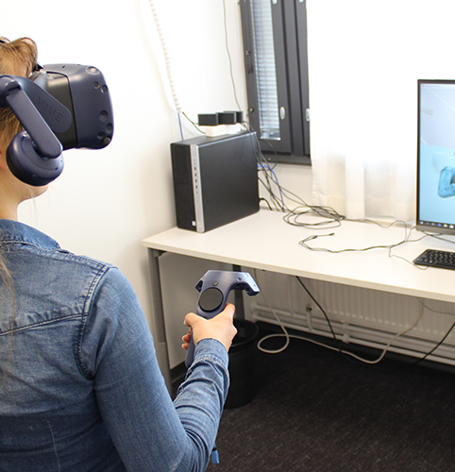
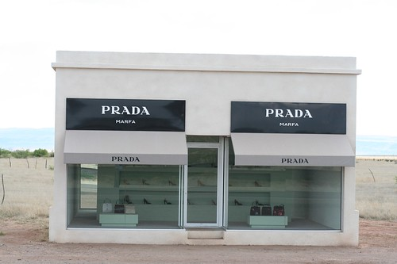
Contrived Setting
Subjects are observed in an environment that has been specially designed for recording their behavior
Fake store
Computer simulation
This Photo by Unknown Author is licensed under CC BY-NC-ND
This Photo by Unknown Author is licensed under CC BY-SA
Notes:
On the other hand, contrived setting is where ..

Slide 36


Human Observation
With human observation, individuals are trained to systematically observe a phenomenon and to record the observational form the specific events that take place
This Photo by Unknown Author is licensed under CC BY-SA
Notes:
The last consideration is method of administration

Slide 37
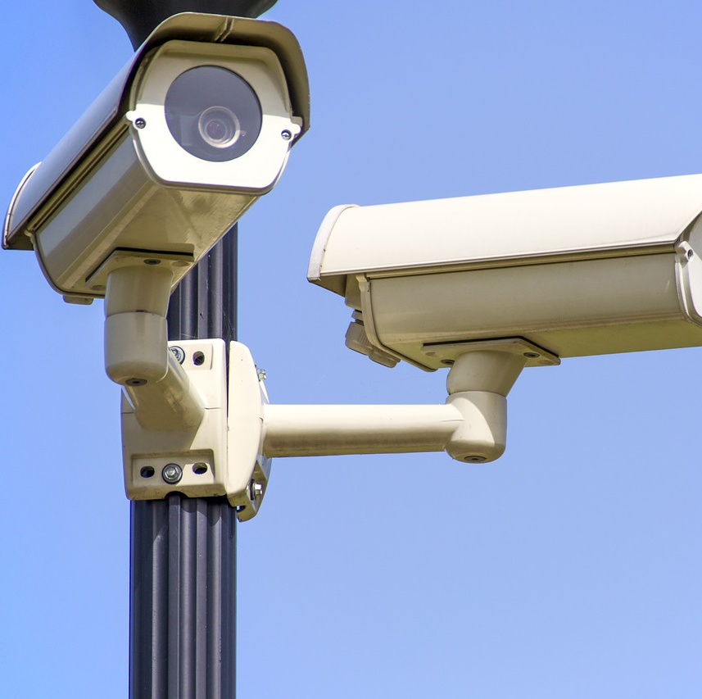
Mechanical Observation
With electrical or mechanical observation, an electrical or mechanical device observes a phenomenon and records the events that take place.
E.g., Video cameras, bar code scanners, response latency, Galvanometer, voice-pitch analysis, eye camera.
This Photo by Unknown Author is licensed under CC BY-ND
Notes:
The last consideration is method of administration

Slide 38
Chapter 11: Collecting Data by Communication
Explain the concept of structure as it relates to questionnaires
Cite the drawbacks of using high degrees of structure
Explain what is meant by disguise in a questionnaire
Discuss two situations in which disguise might be desirable
Differentiate among the main methods of administering questionnaires
Discuss three important aspects used to compare the four different methods of administering questionnaires.
Notes:
And chapter 11 we will go into detail of collecting data by communication

Slide 39
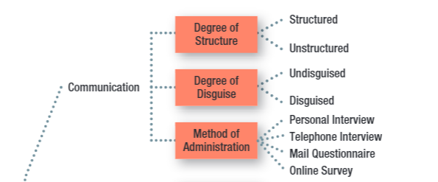
Key Issues for Collecting Information by Communication
Notes:
There are 3 issues for collecting info by communication as well:
Degree of structure
Degree of disguise
Method of administration

Slide 40
Key Issues for Collecting Information by Communication
Fixed-Alternative Questions (structured): Questions in which the responses are limited to stated alternatives
Open-ended question (unstructured): a question in which respondents are free to reply in their own words rather than being limited to choosing from among a set of alternatives.
Notes:
Same as collecting information by observation,
Structure is defined as the degree of standardization used with the data collection instrument

Slide 41
High Structure: Advantages and Disadvantages
Attribute | Disadvantage | Advantage
Ease of Administration |  | 4
Ease of Coding and Analysis |  | 4
Measure Reliability |  | 4
Response Bias:
Forced choice | 4
Omitted response | 4
Precision of response | 4
Notes:
You also have to make tradeoff between structured and unstructured data collection form.
The more structured you have in your questionnaire and data collection process, the easier it is to administer, coding and analysis, and measure reality,
But you also introduce repose bias: which are forced choice, or omitted response (maybe your respondents want to answer the question with a different answer). Or he or she wants to elaborate more, and give more details, but she can’t.

Slide 42
The Ethics of Disguise
Disguise: the amount of knowledge people have about a study in which they are participating
Under the rights model of ethics, the use of disguise amounts to a violation of the respondent’s right to know
Useful when
Knowing the purpose or sponsor is likely to bias respondent’s’ answers
Re-creating the natural environment is necessary, particularly in experimental research
Debriefing: The process of providing appropriate information to respondents after data have been collected using disguise
Notes:
As mentioned in chapter 10, we also care about how much you want to reveal to the respondents.
So disguise is the amount of …
Disguise is especially useful when
Knowing the purpose or sponsor is likely to bias respondent’s’ answers
Re-creating the natural environment is necessary, particularly in experimental research
To counter the unethical part of disguise, we have to debrief the respondents afterward
So debriefing is the process of …
Sometimes, if you watch YouTube video, people usually do some social experiments first, but then they will ask subjects for their consents to participate and show their faces and reactions.

Slide 43

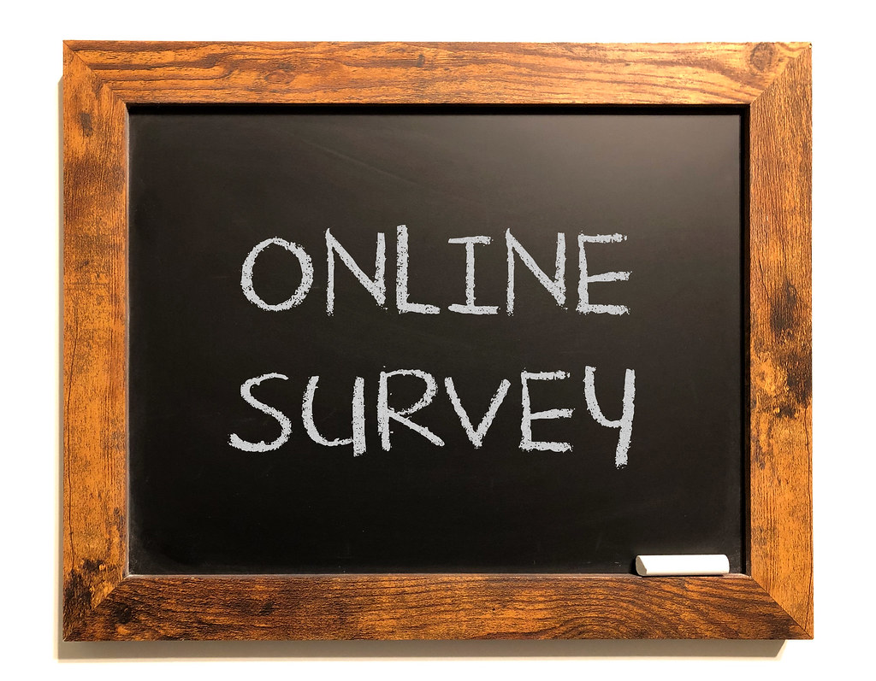

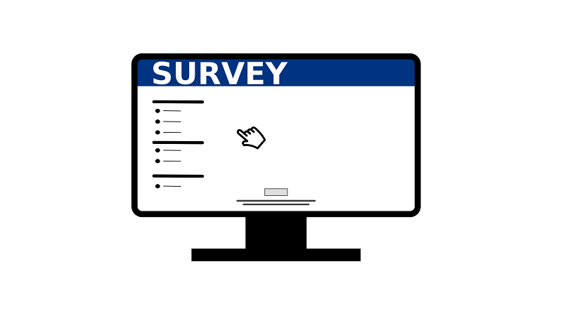
Primary Methods of Administration
Personal Interviews
Telephone Interviews
Mail Surveys
Online Surveys
This Photo by Unknown Author is licensed under CC BY-NC
This Photo by Unknown Author is licensed under CC BY-SA-NC
This Photo by Unknown Author is licensed under CC BY
Notes:
Another issue regarding collecting info by communication is the method of administration

Slide 44
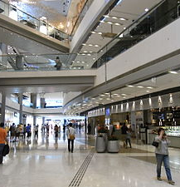
Personal Interview
Direct, face-to-face conservation between a representative of the research organization, the interviewer, and a respondent or interviewee
Can be conducted in lots of different locations (including malls using mall intercepts)
Generally strong sampling control (including higher response rates)
Great flexibility, but higher levels of interviewer bias
Time and cost-intensive
This Photo by Unknown Author is licensed under CC BY-SA

Slide 45
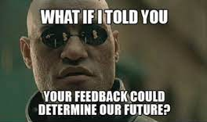
Survey Types
Random-digit Dialing (RDD): A technique used in studies using telephone interviews, in which the numbers to be called are randomly generated
In-bound surveys: A method of data collection in which respondents access a survey by telephone or on the Web to respond to survey items.
Notes:
There are types of survey which are RDD and in-bound surveys
DONOTCALL registry
You don’t have to memorize these types, you can just review it. Or have it when you take your quiz

Slide 46

Mail Survey
A survey administered by mail to designated respondents with an accompanying cover letter. The respondents return the questionnaire by mail to the research organization.
Lower degree of sampling control (mailing lists often available, but no control over who completes survey, and often low response rates)
No interviewer bias and can offer anonymity, but less flexibility (no explanation or follow-up, no complex materials)
Lower cost than personal or telephone interviews.
Notes:
In real world,
Personal interviews 67%
Telephone 61%
Paper-based survey 32% Online survey 97%

Slide 47
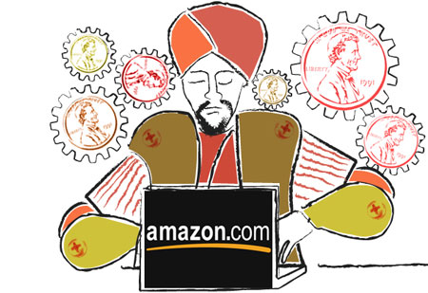

Online Survey
A method of administration that relies on the web for completing the survey
Explosion in use over the past decade
Email lists and panels are readily available, but it’s difficult to know how you are really contacting, response rates are often very low
Good flexibility: visuals and complex material possible
Usually quick and inexpensive
This Photo by Unknown Author is licensed under CC BY-SA-NC
This Photo by Unknown Author is licensed under CC BY-NC

Slide 48
Recap
Chapter 9: Descriptive Primary Data
Chapter 10: Collecting Data by Observation
Chapter 11: Collecting Data by Communication

Slide 49
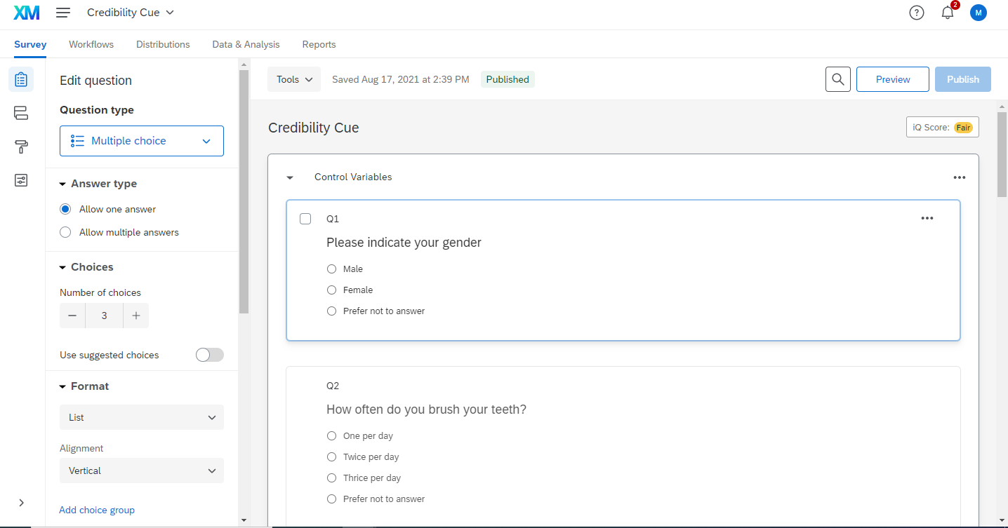
Qualtrics Homework

Slide 50

Case 4
The Red Lion, Ltd., is a chain of 13 bar restaurants located in seven major cities on the east coast. The original Red Lion was opened in 2003 by Albert Campion, an English expatriate. The chain is modeled after the typical English pub. Much of the equipment and furnishings have been collected from actual pubs throughout the British Isles. The Red Lion sells typical English dishes such as fish and chips and kidney pie, as well as a variety of sandwiches and a selection of American and English beers. In addition, Mr. Campion claims to have the largest collection of Scotch whiskeys outside of the British Isles. Mr. Campion feels that "the key to the successful operation of a pub is the maintenance of a friendly, intimate ambiance." He would like to personally oversee the operation of each pub, but that has become impossible as the chain has grown. Because of this, Mr. Campion has invested in hiring top-quality managers, most of whom are from England. Despite the care Mr. Campion has taken, he still feels that he needs some mechanism to ensure that the food and service are of consistently high quality. To this end, Mr. Campion is considering four alternative forms of marketing research:
A short questionnaire is placed on each table. Customers who have criticism, praise, or suggestions are asked to complete the form and give it to their server.
A trained interviewer visits each pub on an unannounced basis. Selected customers are interviewed as they leave the pub.
Mr. Campion contracts a customer experience firm. At the bottom of each customer's receipt is the link to an online survey customers can complete and receive a discount on their next visit to the pub.
None of the above. Instead, rely on posts to sites like Yelp and Facebook to assess customer satisfaction. Discuss the merits of these alternatives and indicate which, if any, you would recommend to Mr. Campion.
This Photo by Unknown Author is licensed under CC BY

Slide 51

Up next
Read chapter 12
Qualtrics Homework – Individual assignment (Sunday)
Quiz 5 (Sunday)
Notes:
I know today we cover 3 chapters, which could be a lot.
So please review my slides after this class and digest it again to comprehend today’s materials.

Slide 52
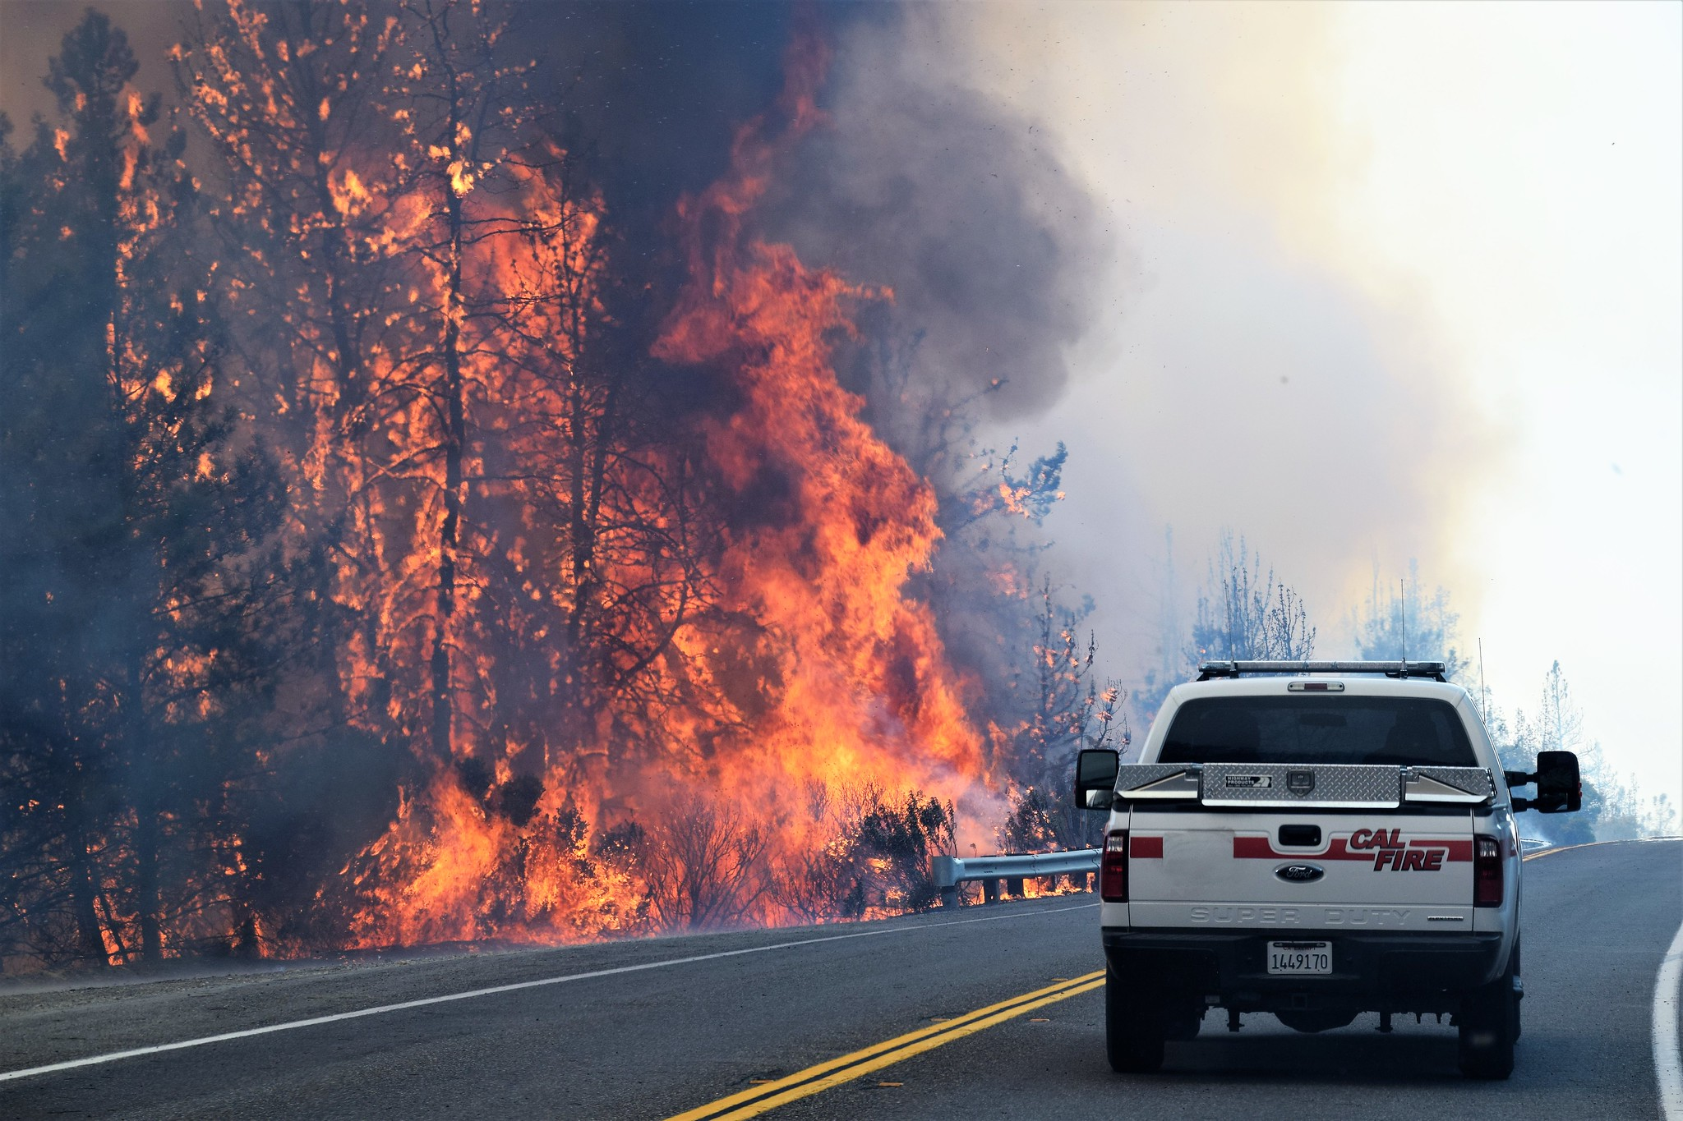
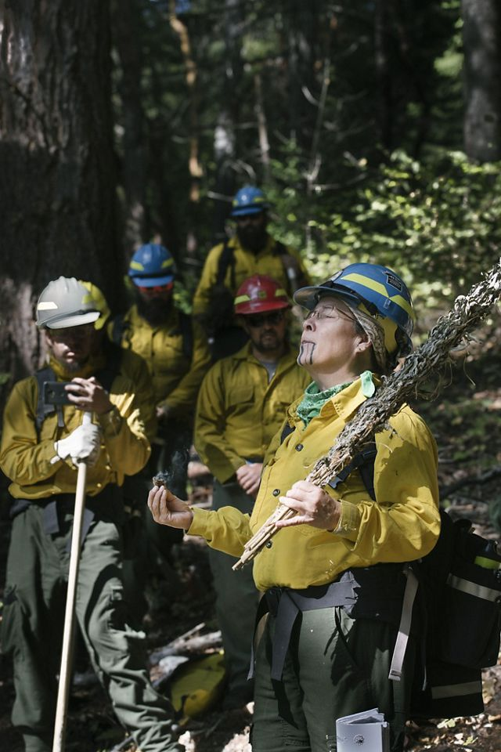
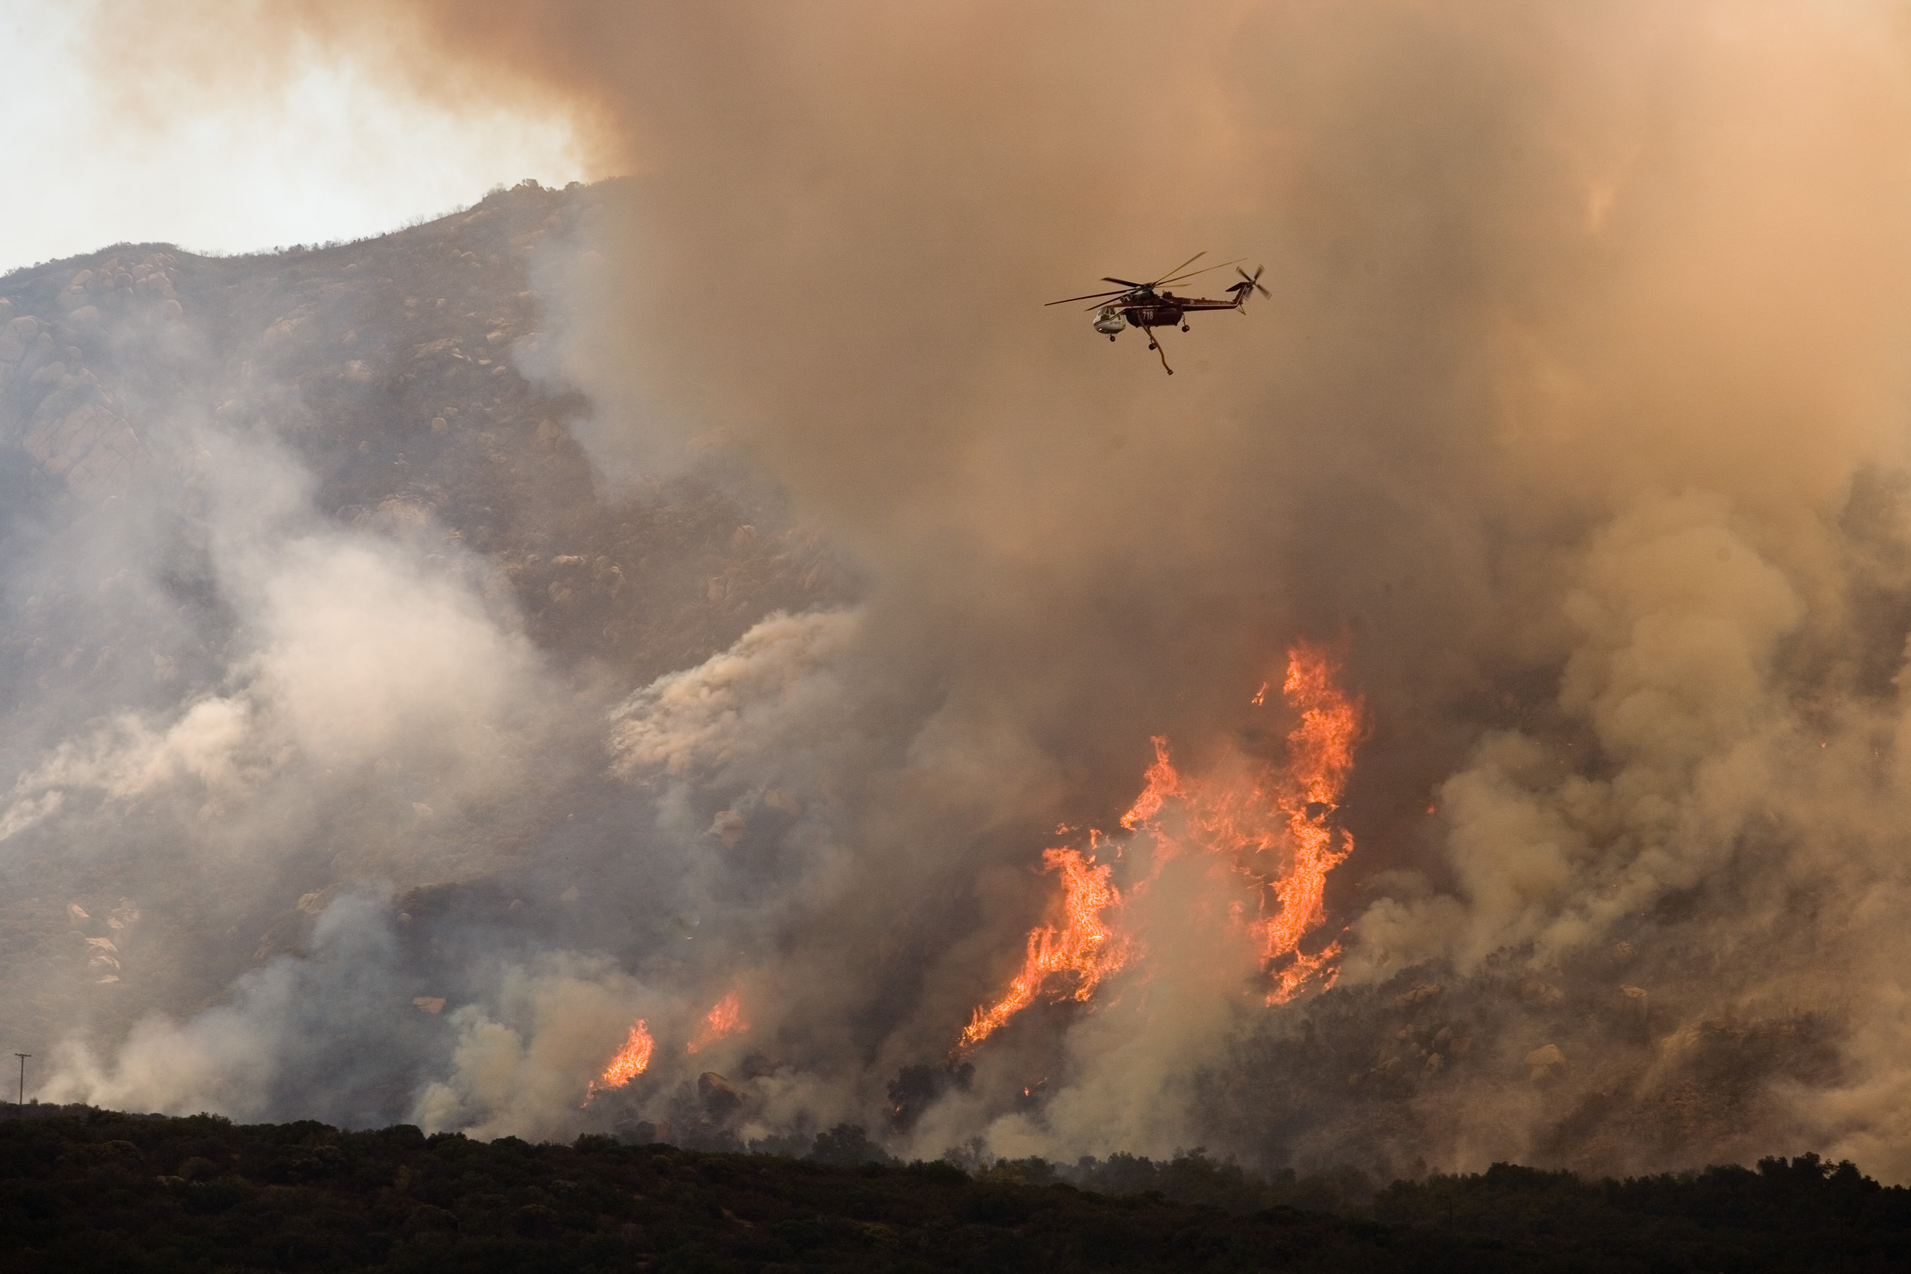
5-min snippet
Fire Model
California fire
Planned burning
History
This Photo by Unknown Author is licensed under CC BY-SA
This Photo by Unknown Author is licensed under CC BY-ND
Notes:
Fire simple model I
Prescribed burning, planned burning, or controlled burning
https://www.nature.org/en-us/magazine/magazine-articles/indigenous-controlled-burns-california/
https://www.motherjones.com/environment/2019/11/californias-wildfire-controlled-prescribed-burns-native-americans/

